Slide 1
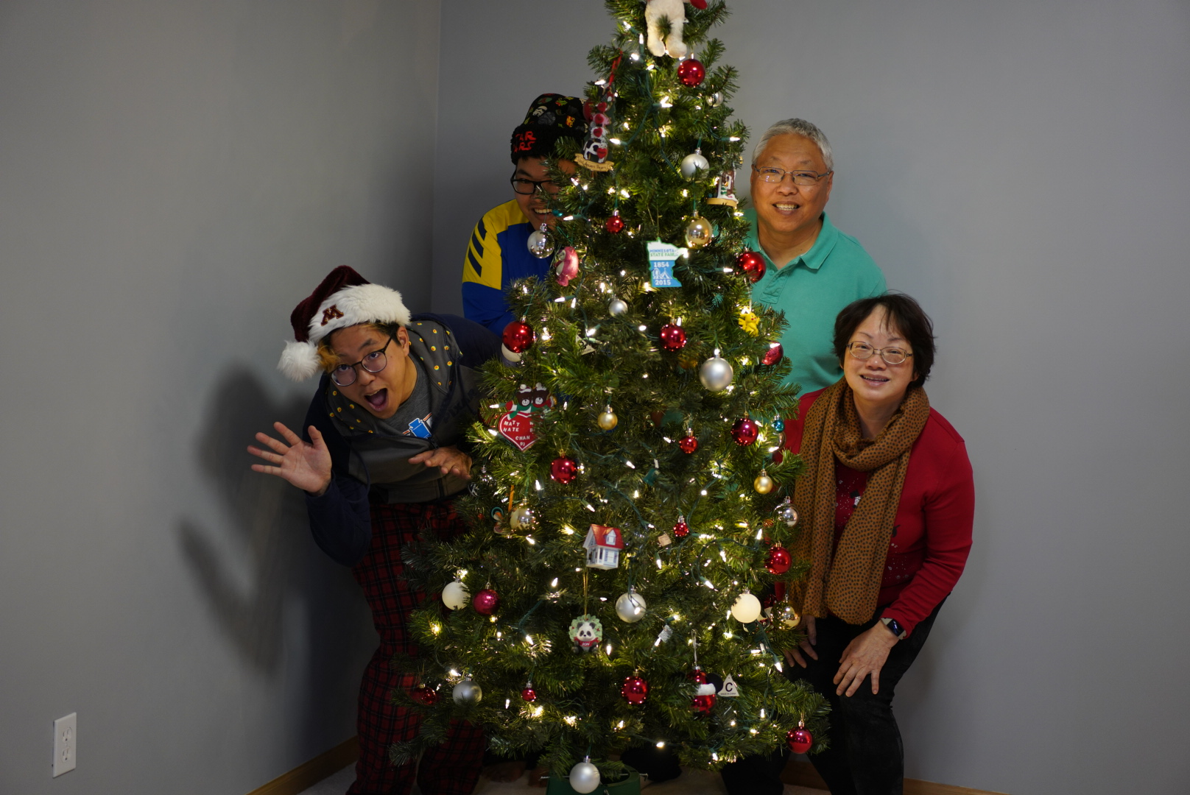


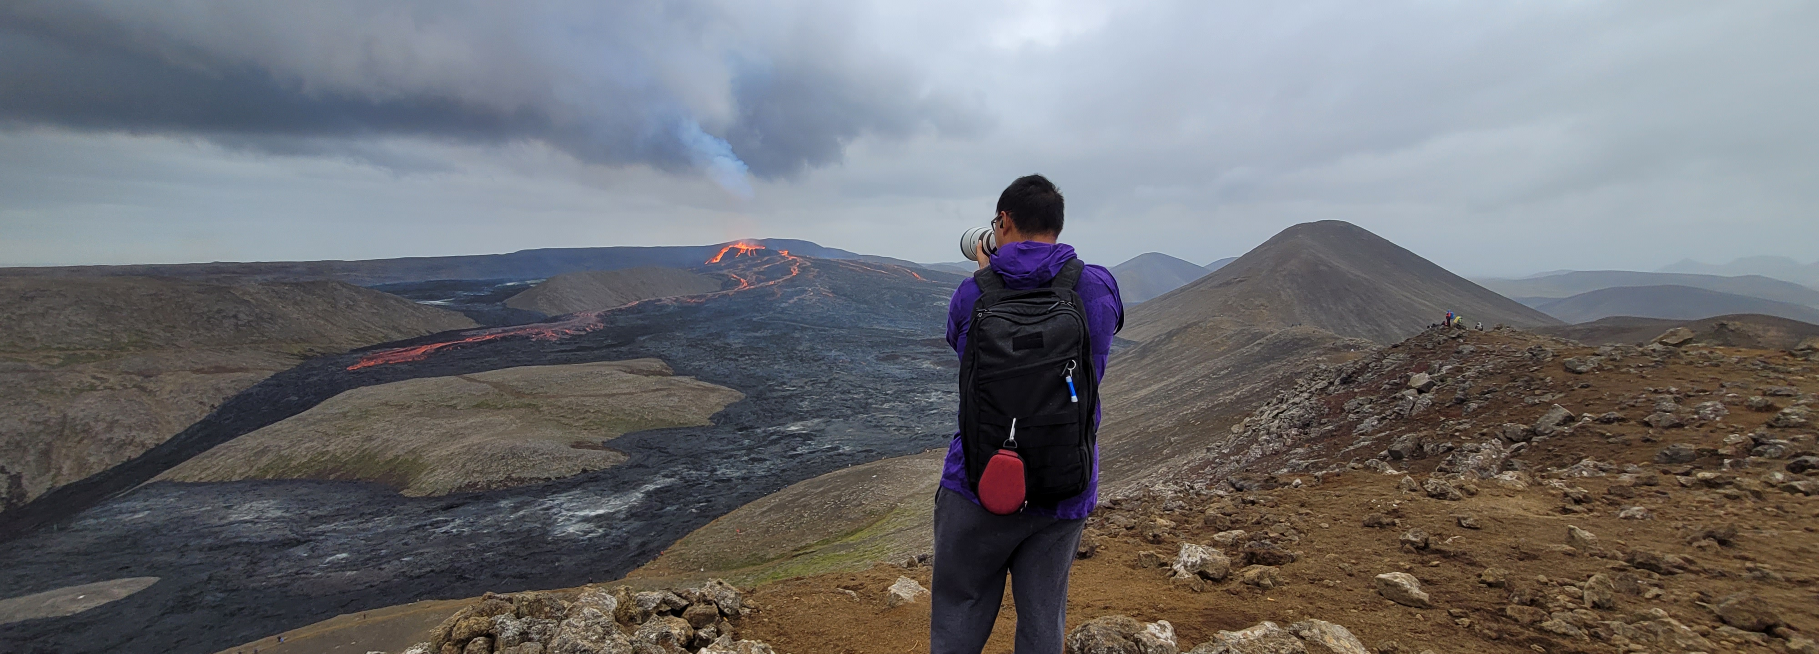





Matthias (Matti) Chan
Personal
Hometown: North St. Paul, Minnesota
Lived in: Minnesota, Missouri, Massachusetts
Work style
Fastest Way to contact me?
Slack
Preferred Way to contact me?
Slack
How do you communicate back to the team?
Whatever they need / prefer
Pet peeves at work?
Work politics; people not doing any research before asking for help (not operating at depth); unnecessary / inefficient meetings; not delivering results or operating as one team (we all win together)
How can someone win a gold star with you?
Get stuff done (#DeliverResults); learn and share new things that you learn
What is your most proud career moment?
When one of my mentees successfully changed careers and became a Data Scientist and is successfully living their dream.
For Fun
Fun Facts
Ran a half marathon in all 50 states (and 7 marathons)
Have finished a 48000 piece puzzle
Hobby/Interests
Minnesota Sports (unfortunately, all of them), jigsaw puzzles, travel, photography
Highlights of background
Work Experience :
Since January 2022
Before Chewy:
Education:
Washington University in St. Louis
PhD (ABD) Systems Science and Engineering
M.S. Systems Science and Engineering
B.S. Systems Science and Mathematics
Minors in Computer Science and Robotics

